Slide 1


Slide 2
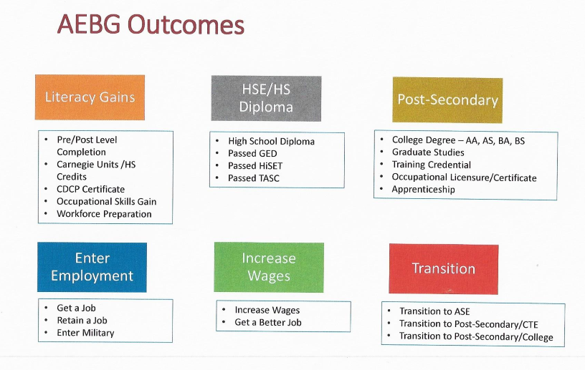

Slide 3
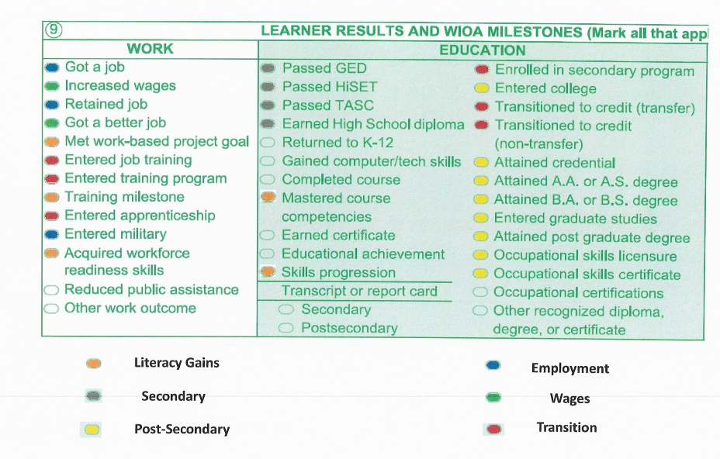

Slide 4
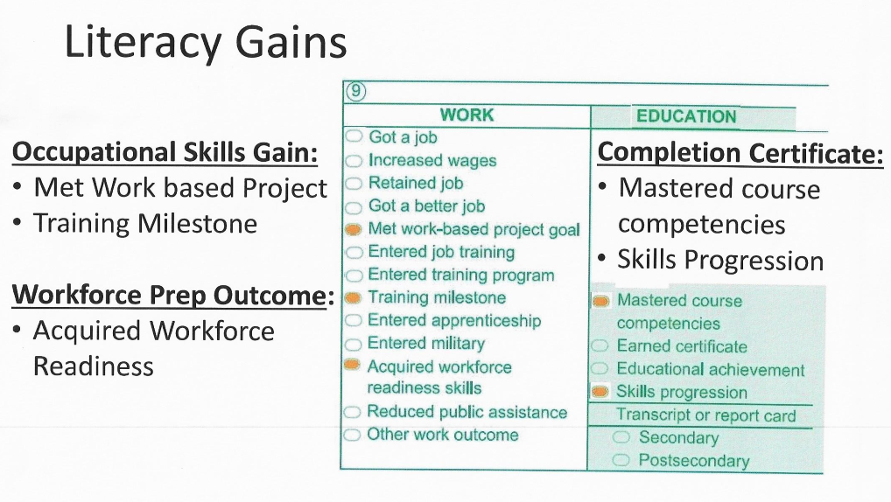

Slide 5
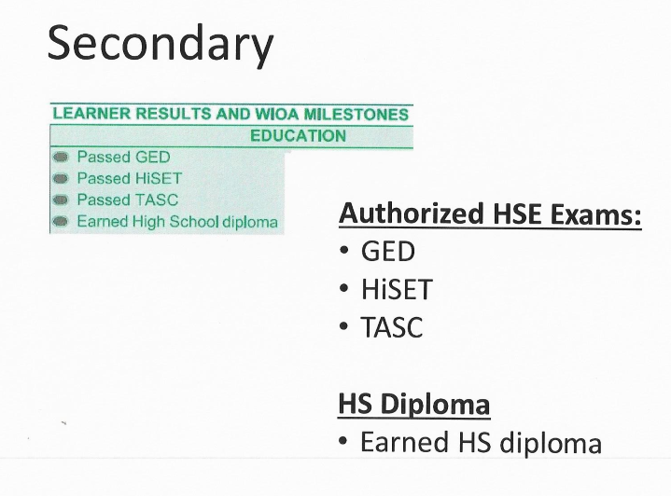

Slide 6
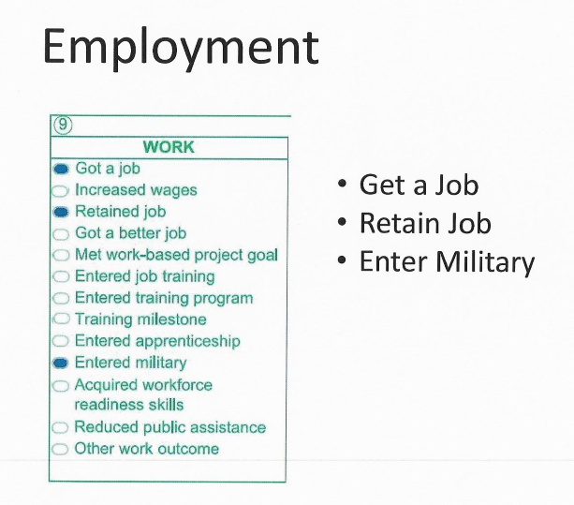

Slide 7
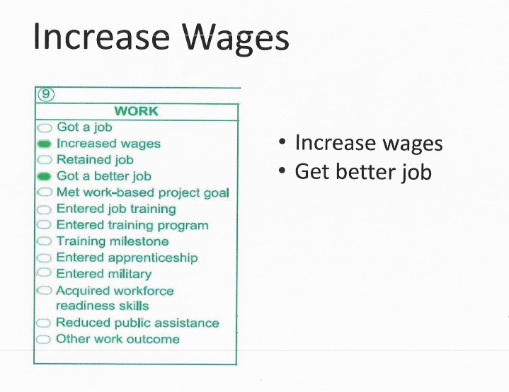

Slide 8
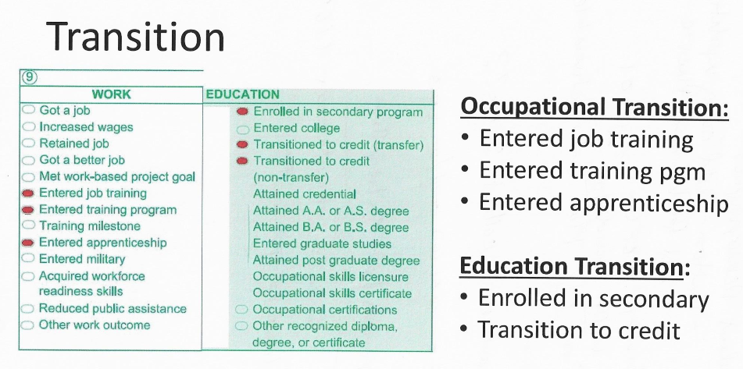

Slide 9
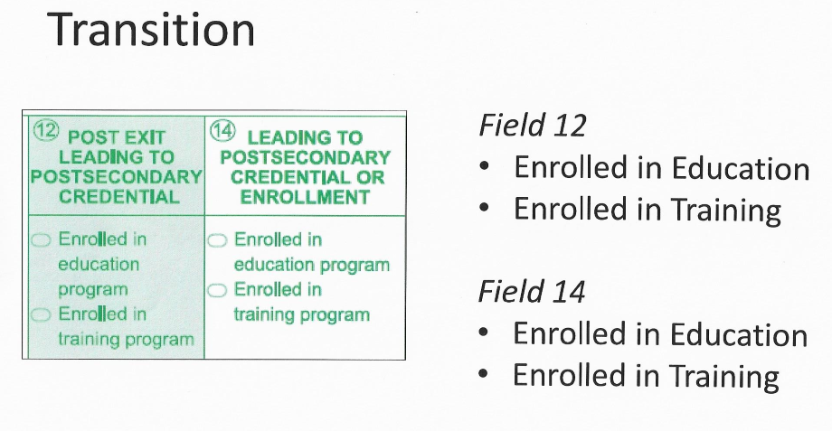

Slide 10
How to Achieve AEBG Literacy Gains by Using CASAS Testing
Students must advance one Educational Functional Level (EFL) in order to achieve a Literacy Gain.
EFLs are as follow:
  Level 4: 201-210
  Level 5: 211-220
  Level 6: 221-235
  Level 7: 236-245
  Level 8: 246+

Slide 11
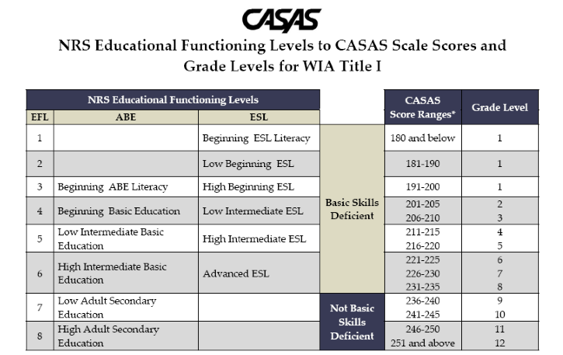
CASAS
EFLs, Scale Scores, and Grade Levels

Slide 12
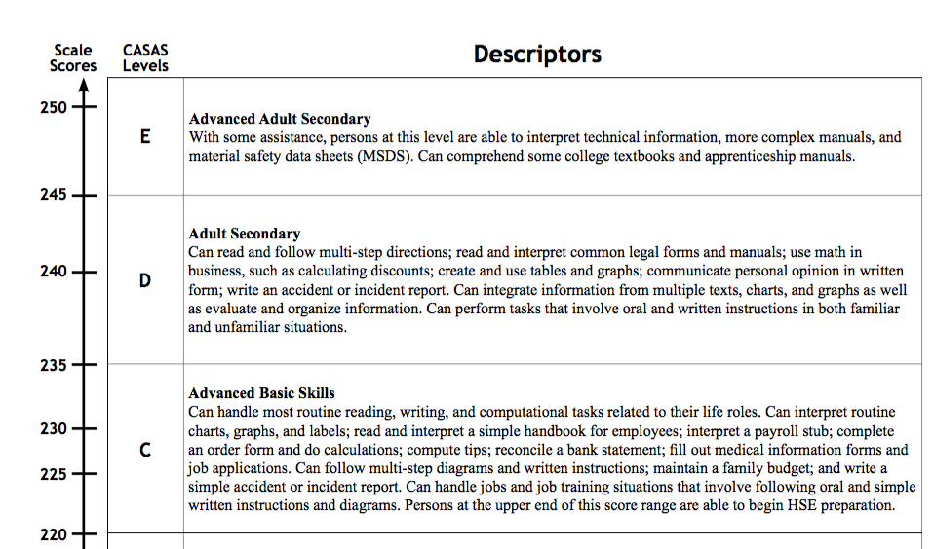
CASAS
Descriptors Levels 6 – 8

Slide 13
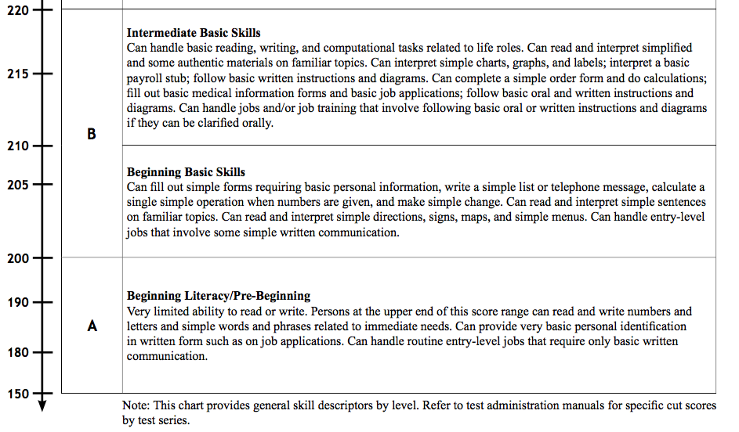
CASAS
Descriptors Levels 1 – 5

Slide 14
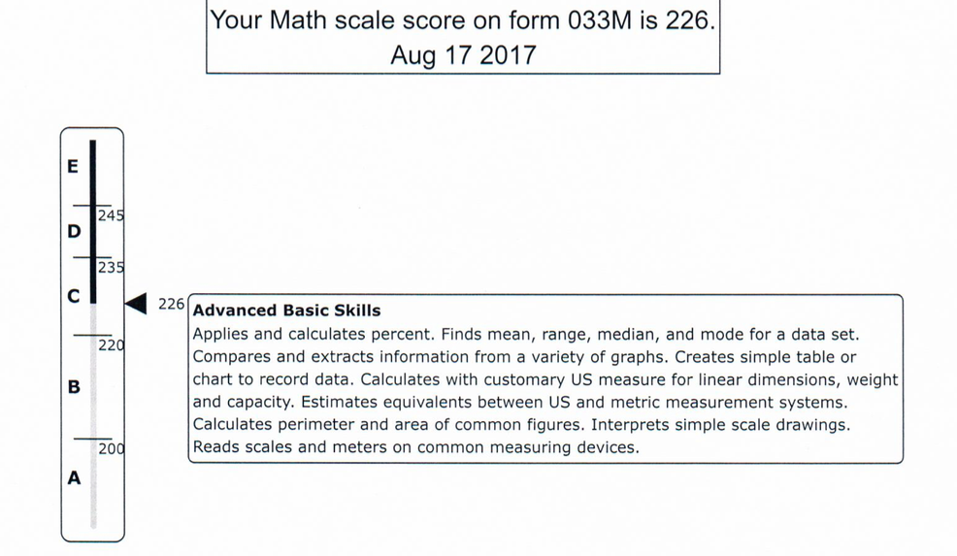
CASAS
Student Score

Slide 15
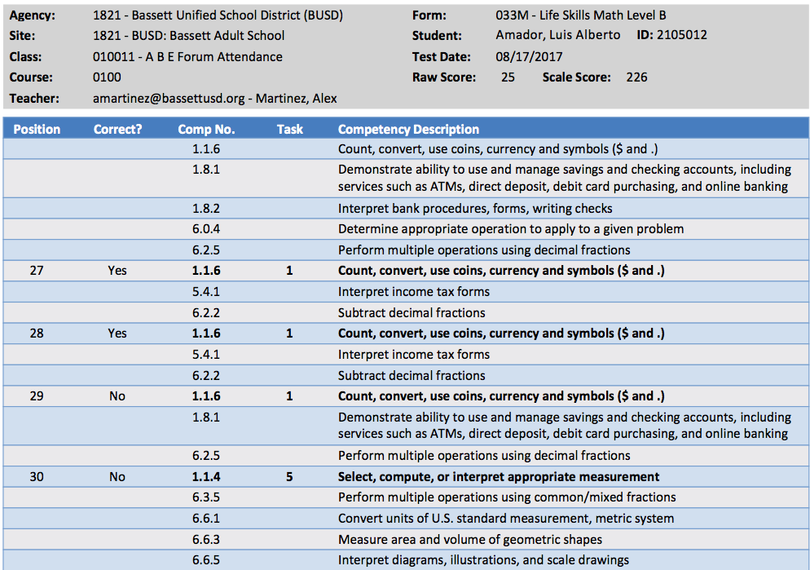
CASAS
Student Competency Report

Slide 16

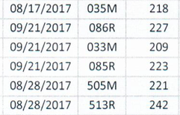
CASAS
Student Scores by Class

Slide 17
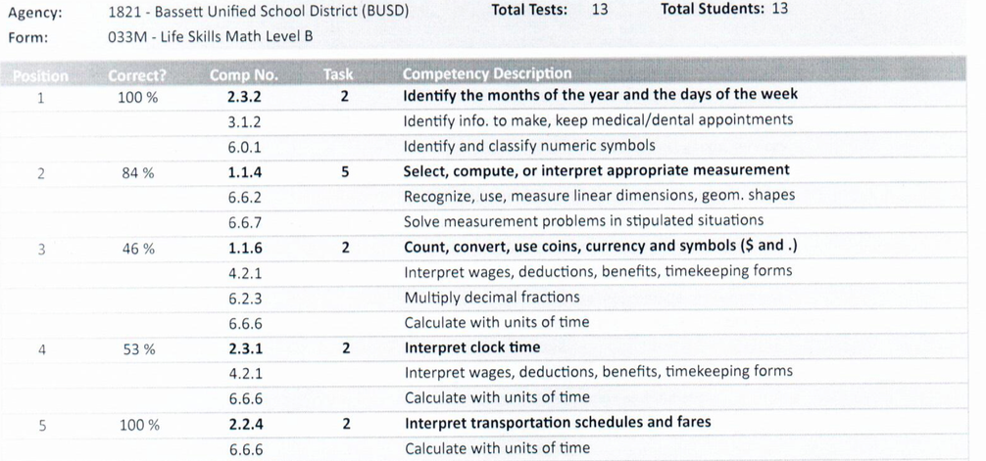
CASAS
Competencies Report

Slide 18
What are CB 21 Rubrics?
CB 21 Rubrics are a set of rubrics used in English and Math at the community college level. These rubrics identify and outline the learning outcomes needed in order for students to transfer to college level courses.
The CB 21 levels presented indicate a student’s readiness to transfer to college level courses and can help determine whether or not a student is basic-skills deficient.
The following chart shows the correlation between CB 21 rubrics, CASAS Information (EFLs, Scores, and Grade Levels), and TABE Scores.

Slide 19
CB21 – CASAS – TABE
 | CB21 Transfer Level English, Reading, or Math | CASAS EFL Score Grade Level | TABE
 | CB 21 A – Reserved for non-ASE Courses in English, Reading, or Math | (Intentional Gap) | (Intentional Gap)
Not Basic Skills Deficient | CB 21 B – ASE Highest Level | High Adult Secondary 8 251 and above 12th 8 246-250 11th | 11 – 12.9
Not Basic Skills Deficient | CB 21 C – ASE Lowest Level | Low Adult Secondary 7 241-245 10th 7 236-240 9th | 9 – 10.9
Basic Skills Deficient | CB 21 D – ABE Highest Level | High Intermediate Basic Education 6 231-235 8th 6 226-230 7th 6 221-225 6th | 6 – 8.9
Basic Skills Deficient | CB 21 E – ABE Intermediate Level | Low Intermediate Basic Education 5 216-220 5th 5 211-215 4th | 4 – 5.9
Basic Skills Deficient | CB 21 F – ABE Beginning and Literacy Level | Beginning Basic Education 4 206-210 3rd 4 201-205 2nd | 2 – 3.9

